Slide 1
Day 12 -
Divide and Conquer
Math 495R (Sec 9) - Competitive Coding

Slide 2
Business
Math Problem Set pushed back to be due SATURDAY
Divide and Conquer Problem Set due next Saturday
Out of town Sat, Feb 29 - Wed, Mar 3
No class next Tuesday! Also no office hours while I’m gone

Slide 3
Divide and Conquer Algorithm
Breaking down an optimization problem
Use solutions to subproblems
Recurrent!
Very similar to Dynamic Programming
No need to memoize
Dynamic Programming builds solution incrementally (additively) f(n), f(n-1), f(n-2), …, f(0)
Divide and Conquer builds using multiplicatively f(n), f(n/2), f(n/4), …, f(0)
-Correctness usually proved by induction

Slide 4
Steps to a Divide and Conquer Algorithm
Pre-processing (sometimes)
Recurrent Function
Base Cases
Construct solution from simpler subsolutions
Post-processing (sometimes)

Slide 5
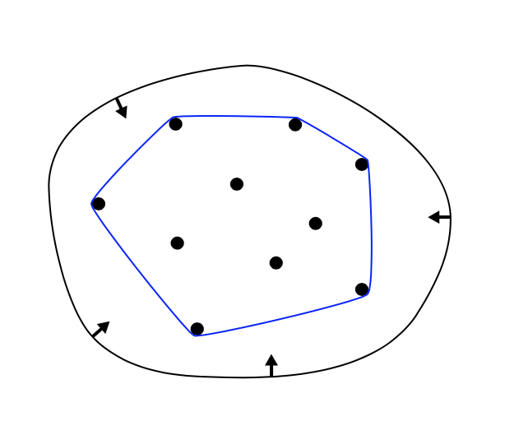
Examples - Convex Hull
Given a set of points, what is the minimum covering convex set?

Slide 6
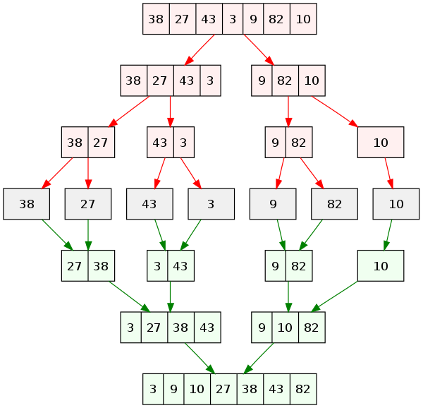
Examples - Merge Sort

Slide 7
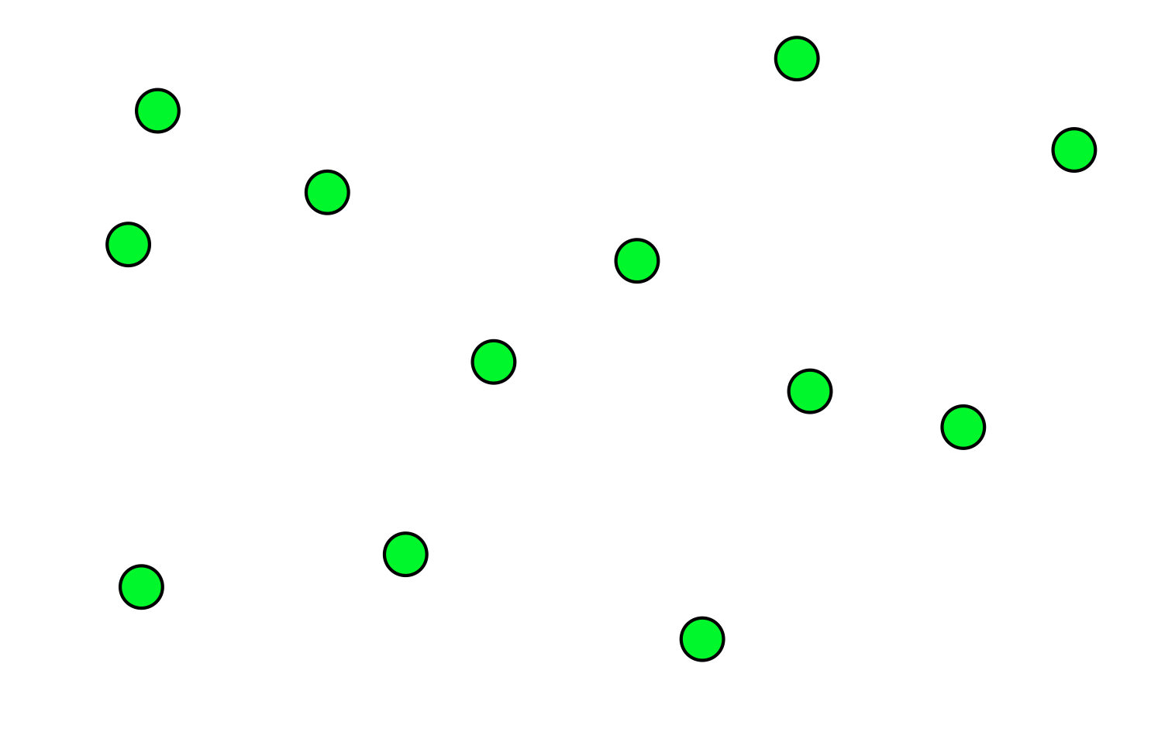
Examples - Closest Points
Given a set of points, what is the distance between the two closest points?
Naive: O(n^2)
Divide and Conquer: O(nlogn)
https://www.cs.cmu.edu/~ckingsf/bioinfo-lectures/closepoints.pdf

Slide 8
Examples - Maximum Subarray
Given an array of positive and negative integers, what is the maximum sum of a contiguous subarray?
Ex: [3, 1, -10, 2] - 4
Naive: O(n^2)
Divide and Conquer: O(nlogn)

Slide 9
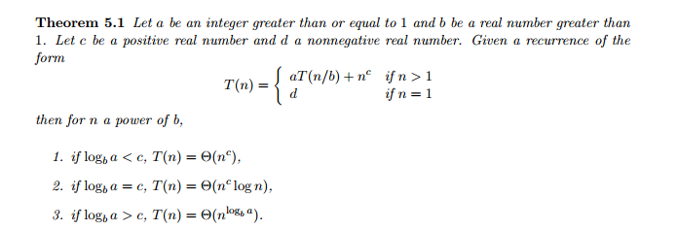
Analyzing Divide and Conquer Runtime

